Slide 1

COSC-5455 Term Project Presentation
Fine-tuning Strategies Based on DreamBooth
Yueran Cao
Zhengheng Li
Xizhong Xu
Zinian Wang

Slide 2
Outline
Overview by Yueran Cao
Methodology by Xizhong Xu
Experiments by Zhengheng Li
Evaluation by Zinian Wang

Slide 3
Overview

Slide 4
Overview: Text-to-Image Generation Models
Rapid Development:
Significant progress in deep learning has enabled the generation of high-quality, semantically rich images from textual descriptions.
Applications:
Advertising
Creative Contents
Virtual Reality

Slide 5
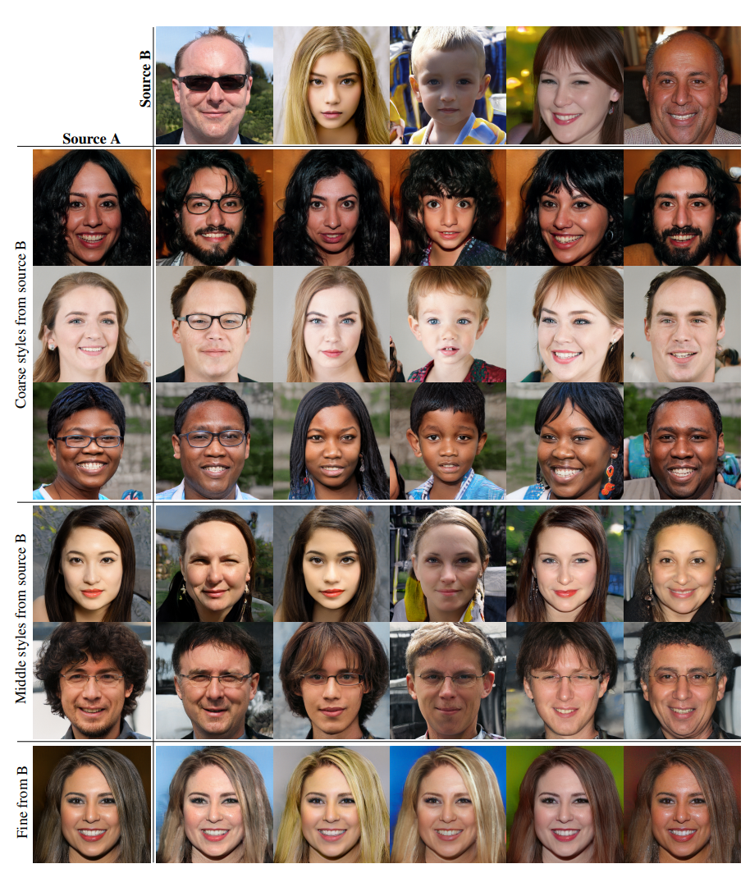
Advances in Core Technologies
Generative Adversarial Networks (GANs)
Representative Model: StyleGAN [1]
Strengths:
High-resolution image generation
Limitations:
Struggles with semantic understanding, diversity, and consistency in complex scenarios.

Slide 6
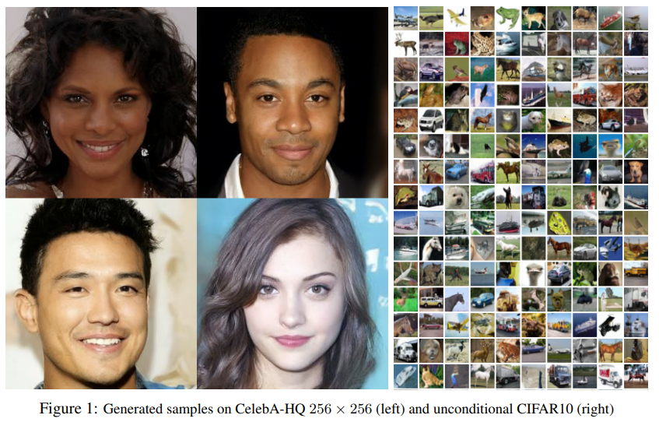
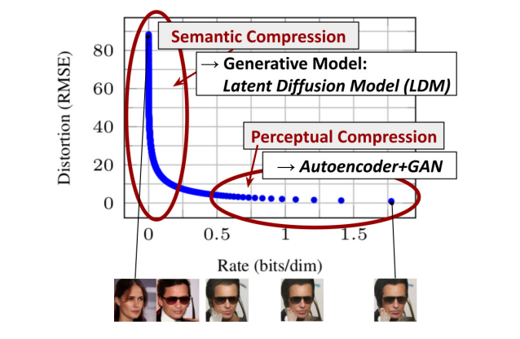
Advances in Core Technologies:
Diffusion Models
Representative Model: DDPM [2] and Stable Diffusion [3]
Key Features:
Stepwise denoising process generates high-quality images.
Seamlessly integrates semantic information for diverse, realistic outputs.

Slide 7
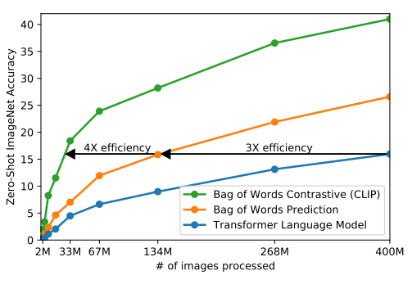
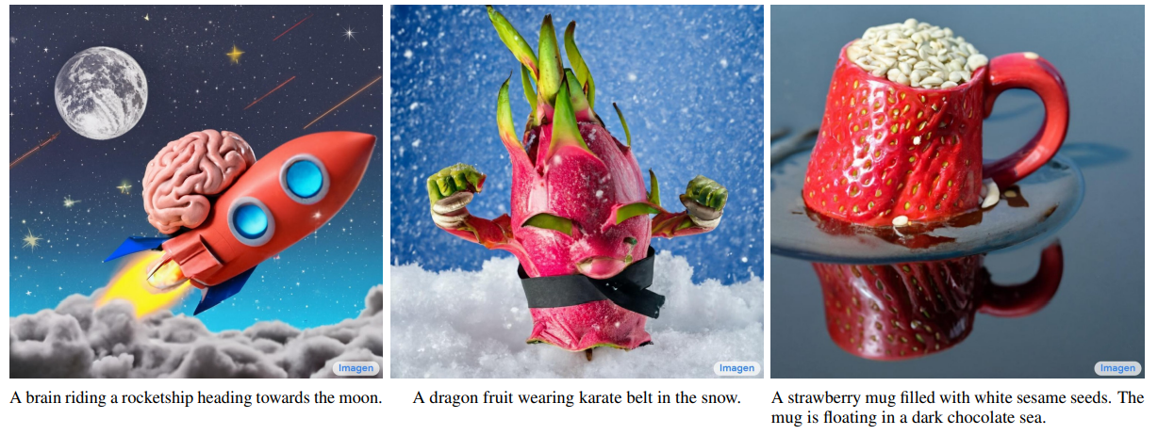
Advances in Core Technologies:
Multimodal Models
CLIP [4]:
Bridges text and image spaces for multimodal tasks.
Imagen [5]:
Combines language models with diffusion models for semantically rich image generation.

Slide 8
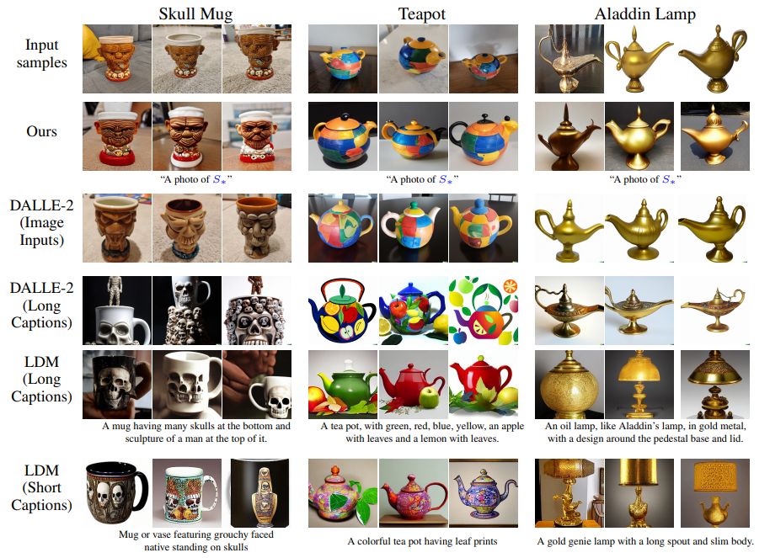
Limitations of Existing Methods:
Subject Consistency Issues
Models lack the ability to retain memory of specific subjects.
Example: Fails to generate images identical to the reference subject, even with detailed text prompts.
Textual Inversion [6]:
Attempts at personalization,
but struggles with preserving
subject fidelity.

Slide 9
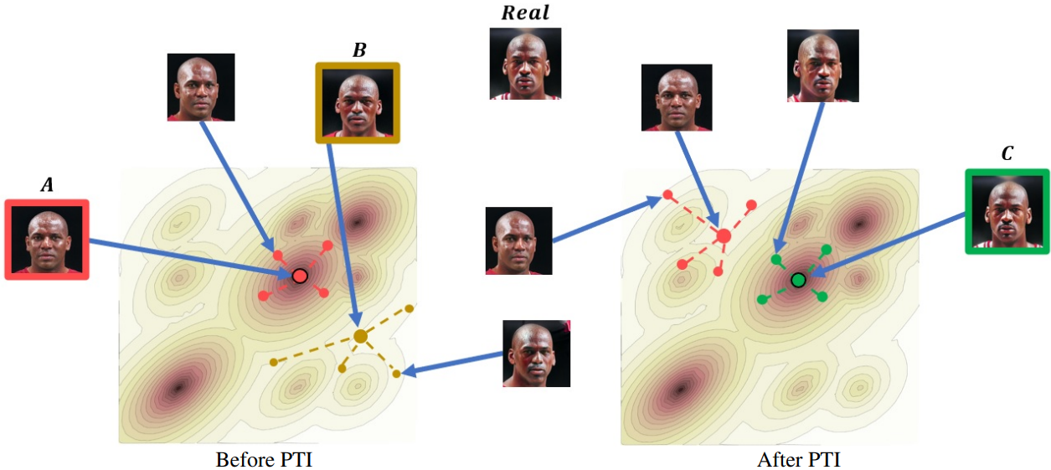
Limitations of Existing Methods:
Data Requirements and Generalization
Pivotal Tuning [7]:
Performs well for face personalization but requires large datasets and is limited to specific domains (e.g., faces).
GANs and diffusion models often overfit or experience mode collapse in few-shot (limited data) settings.

Slide 10
Why DreamBooth?
Designed for Personalized Generation
Embeds specific subjects with only 3-5 images.
Builds on Pre-Trained Diffusion Models
Leverages existing semantic knowledge for flexibility and generalization.
Preserves Subject and Diversity
Maintains subject identity across contexts while avoiding overfitting.
Supports Research Goals
Enables experiments on parameter effects

Slide 11
Project Directions
Goals:
Use diverse portrait photos to train the model and analyze the impact of parameter variations on generated outputs.
Key Steps:
Model Training
Fine-tune DreamBooth using different sets of portrait photos.
Parameter Variation Analysis
Evaluation

Slide 12
Methodology

Slide 13
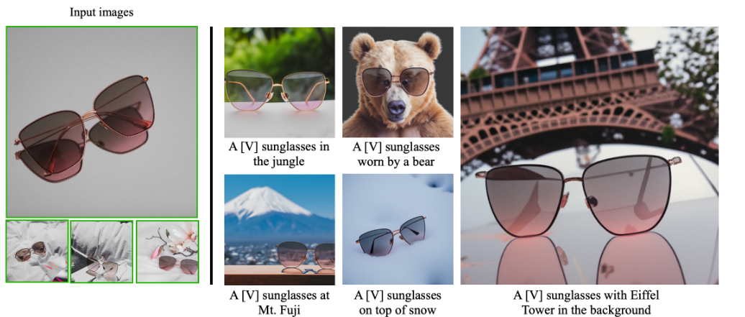
What is DreamBooth?
DreamBooth is a fine-tuning method
It can generate a myriad of images of the subject in different contexts
This model takes as input a few images (typically 3-5 images suffice) of a subject

Slide 14
Methodology
Key methods:
Text-to-Image Diffusion Models and Personalization
Personalization of Text-to-Image Models
Class-specific Prior Preservation Loss
Key points:
Fine-tuning text-to-image diffusion models.
Binding rare identifiers to specific subjects.
Prior-preservation loss to address language drift.

Slide 15
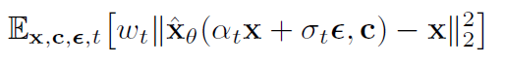
Methodology:
Text-to-Image Diffusion Models and Personalization
Diffusion models are probabilistic generative models that are trained to learn a data distribution by the gradual denoising of a variable sampled from a Gaussian distribution.
Training Goal:
Minimize the denoising error to improve fidelity.
Input and Output:
Input: Initial noise image and text prompt
Output: Generated image

Slide 16
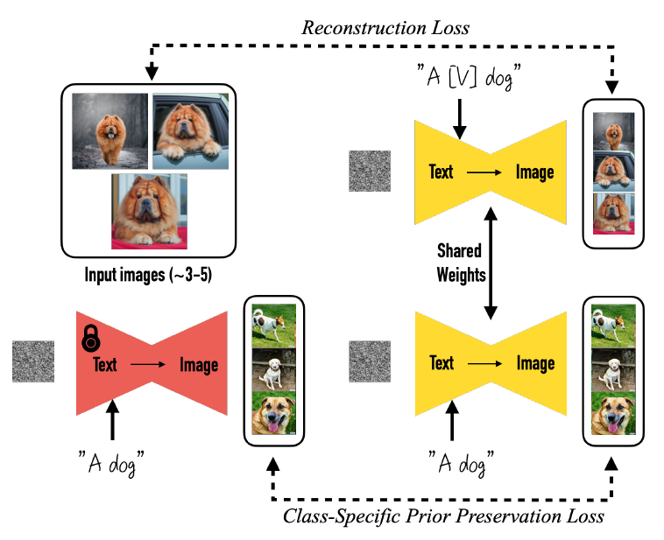
Methodology:
Personalization Text-to-Image Diffusion Models
Natural Idea:
Fine-tune the model with a few subject images and a text prompt containing a rare identifier.
Author’s method:
Allows the model to retain some prior knowledge and then overfit to this small dataset.
e.g., [V] dog represents a unique identifier for a specific dog
Key tech:
Leveraging Prior Knowledge
e.g., "A dog" for A [V] dog
Rare Token Selection
Avoid conflicts with pre-existing semantics

Slide 17
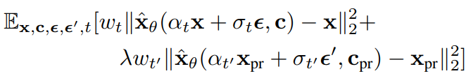
Methodology:
Class-specific Prior Preservation Loss
Outputs are overly similar to training images without Prior-Preservation Loss.
Training Goal:
Overcome language drift and reduced output diversity
Solution:
Use generated samples from the pre-trained model as supervision to retain class prior.
Include a prior-preservation term in the loss function to balance subject fidelity and diversity.

Slide 18
Experiments

Slide 19
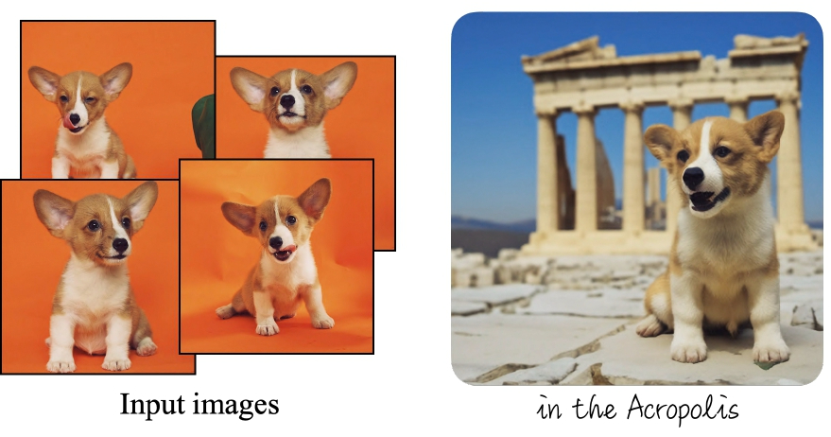
Experiments
Fine-tuning faces on Stable Diffusion v1.5 with DreamBooth.
Original work fine-tuned with objects while ours fine-tuned with faces:
Original: 4-6 images per subject, non-human.
Ours: requires more images per subject and more training steps to generated acceptable results.
MUCH LONGER!!!
Corgi: that’s not me

Slide 20
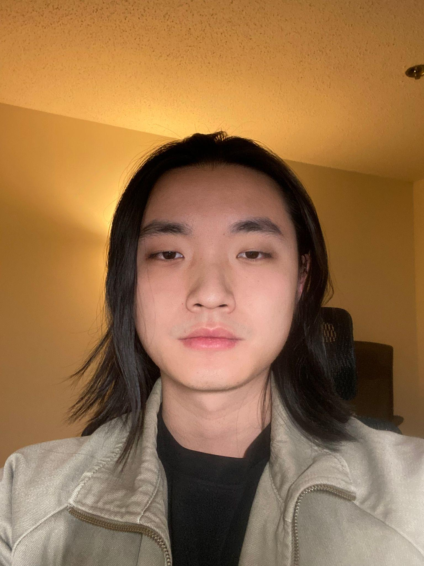
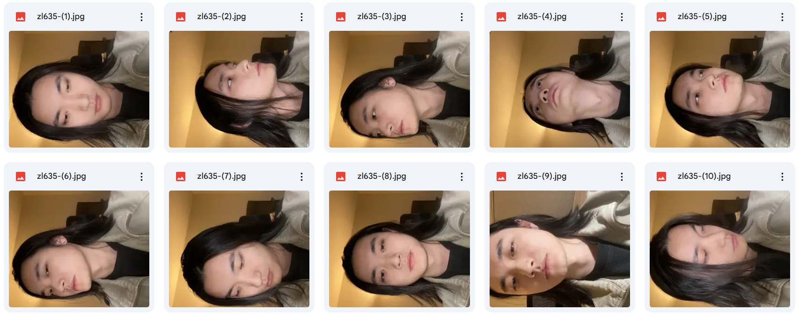
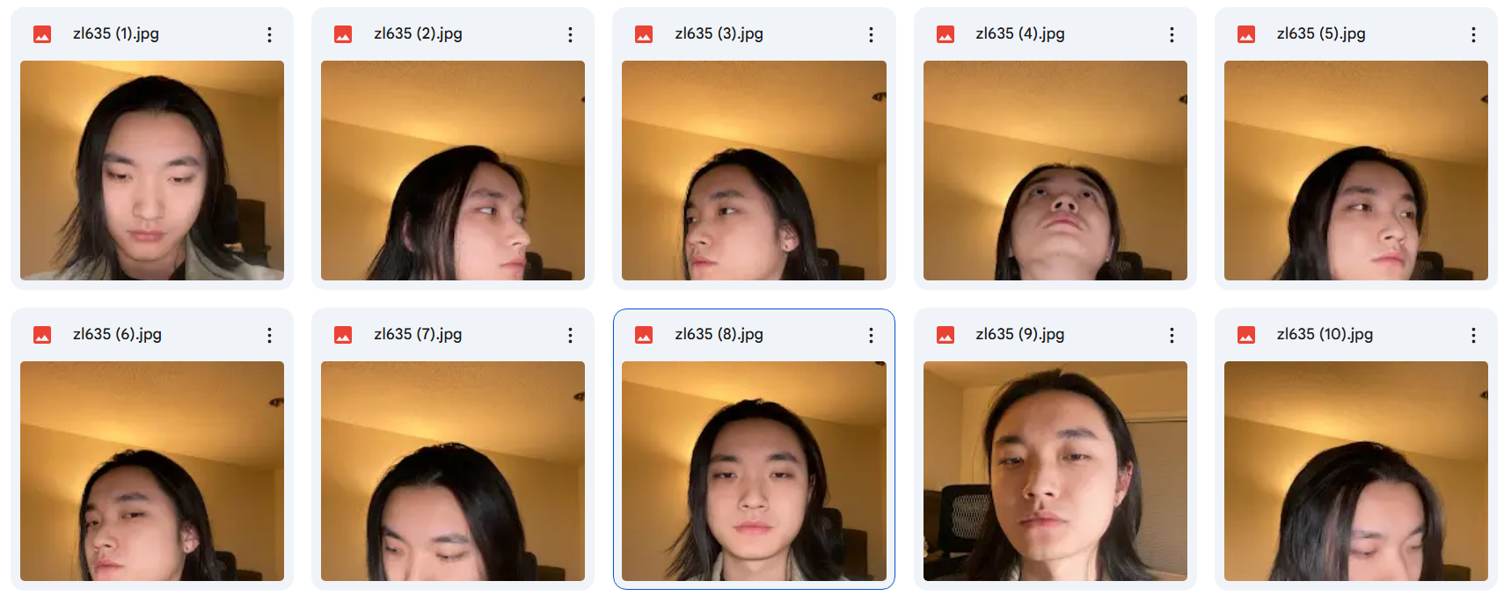
Experiments
1st attempt, naming: zl635 (GU ID)
Unprocessed training images, used Smartcrop to crop images to 512*512.
10 instances, 100 training steps per instance, 1000 total steps, LR = 2e-6.
Smartcrop
For some reason, images were rotated after applying Smartcrop.

Slide 21
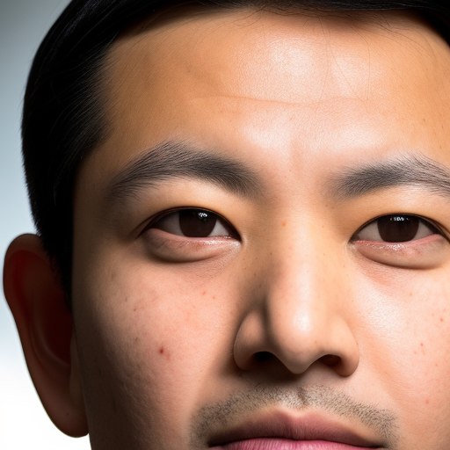
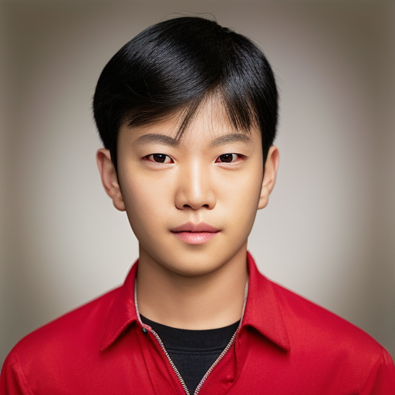
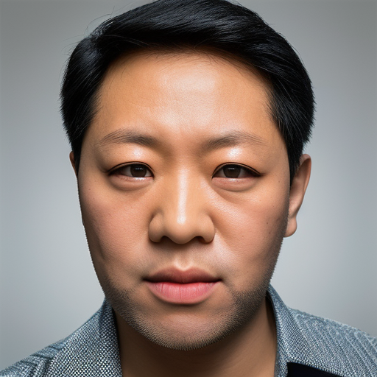
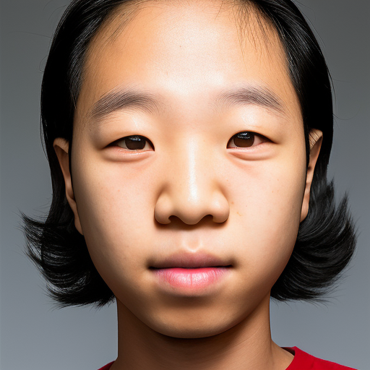
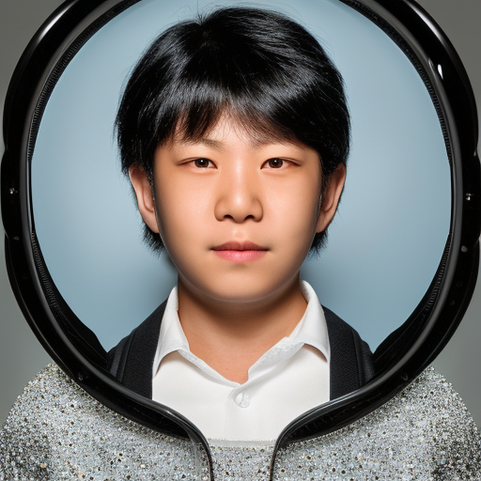
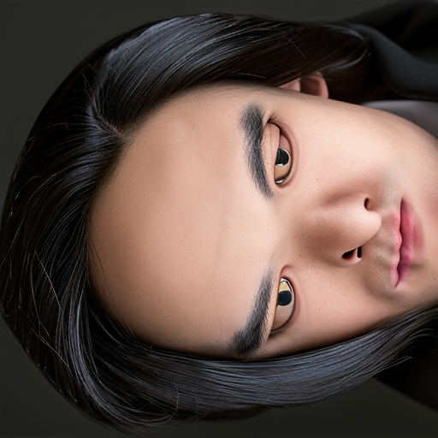
Experiments
Horrible results!
???

Slide 22
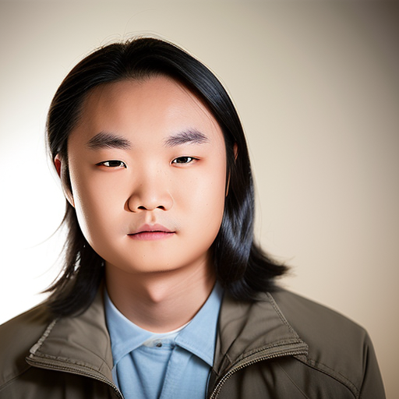
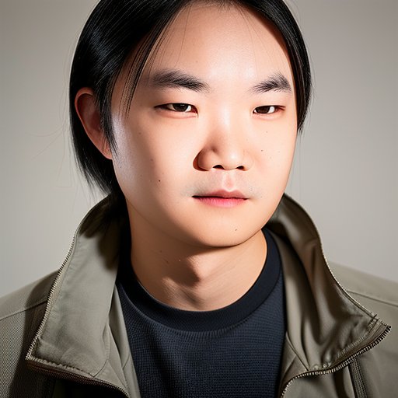
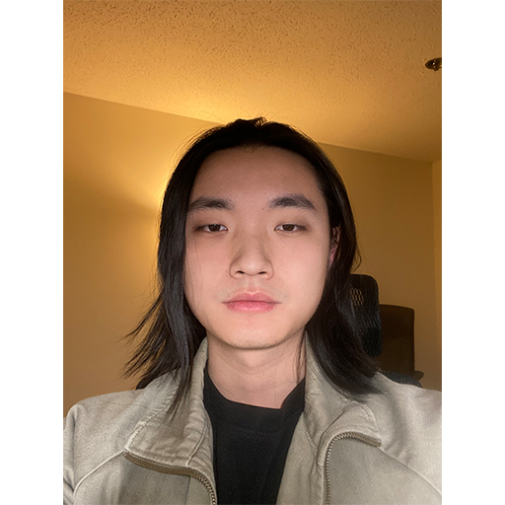
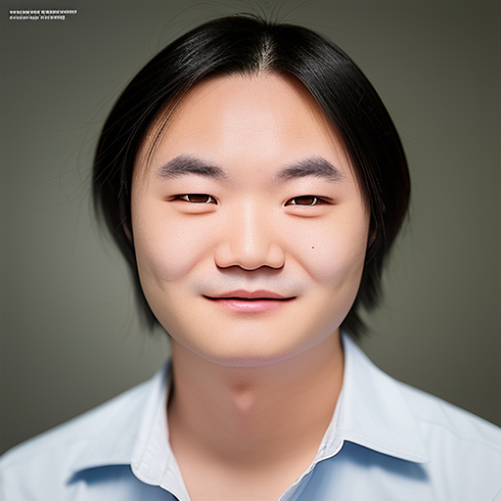
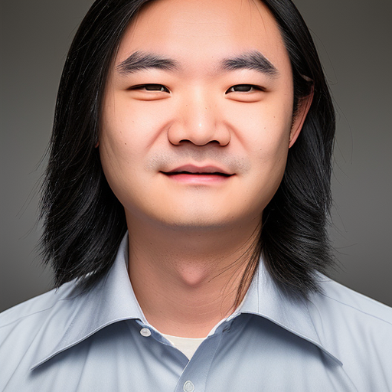
Experiments
Second attempt: zl635_002
Preprocessed data by adding white borders and manually set to 512*512, not rotated this time
Increased steps per instance to 150 (from 100).
Generate

Slide 23
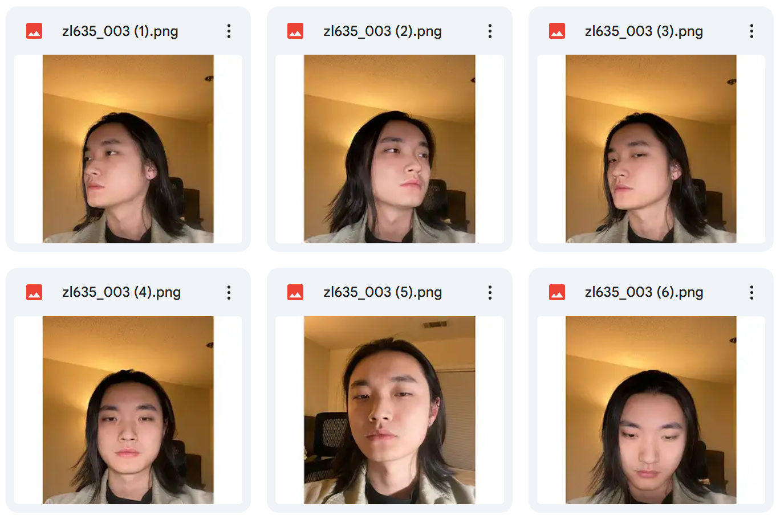
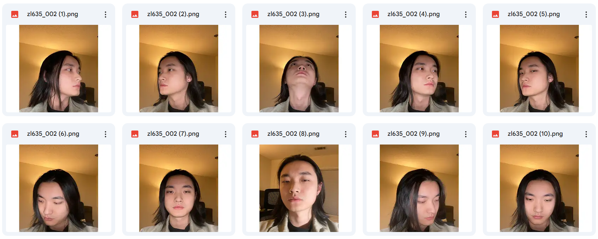
Experiments
zl635_003 and zl635_004
Removed images where face is turned too much. 10 instances to 6 instances.
Before
After

Slide 24
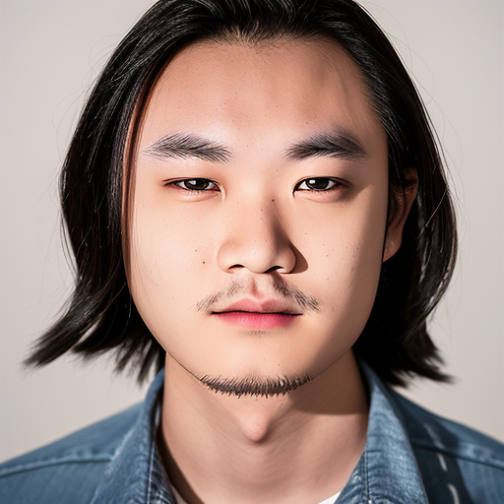
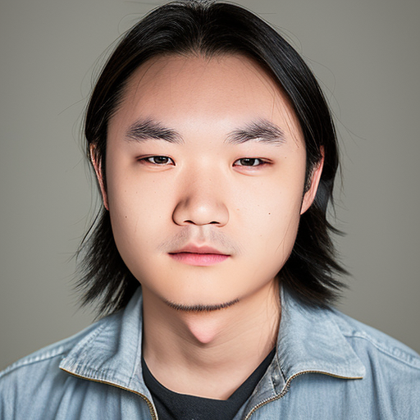
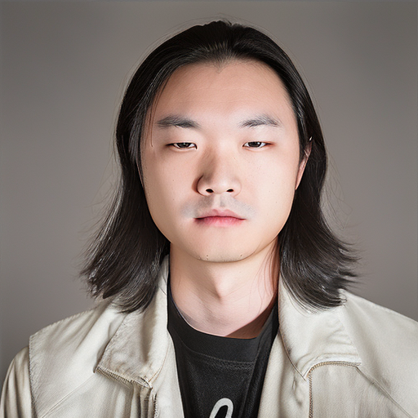
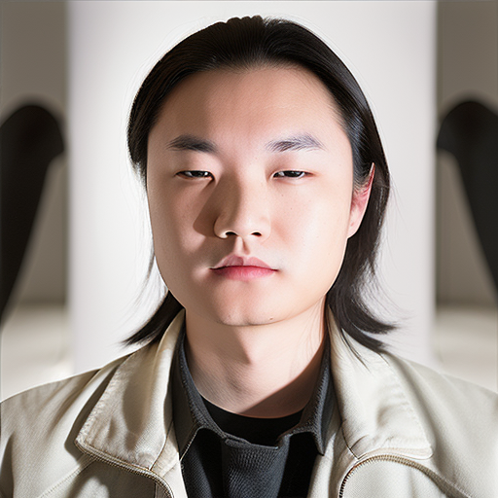
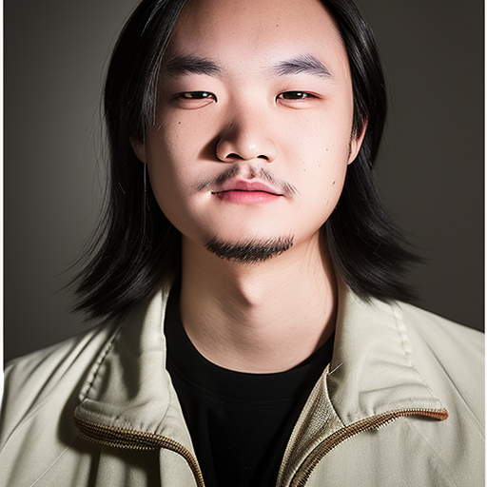
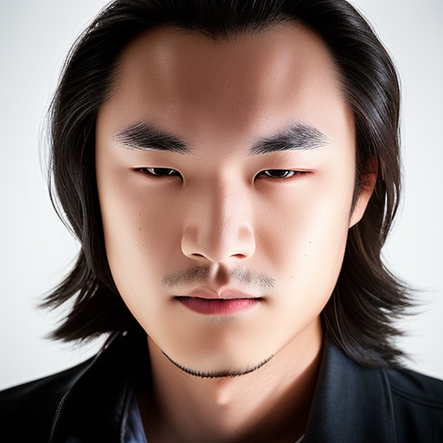
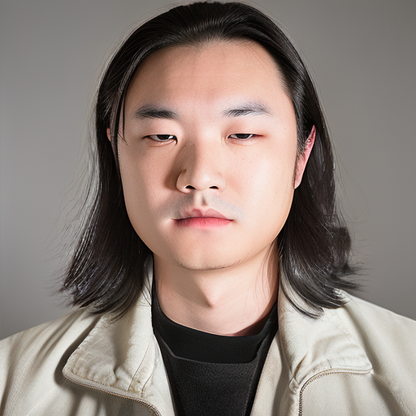
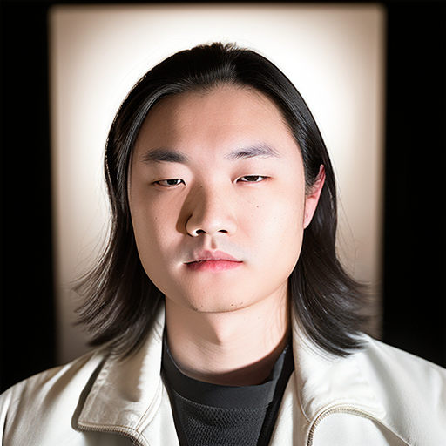
Experiments
zl635_003: 150 steps per instance
zl635_004: 500 steps per instance

Slide 25
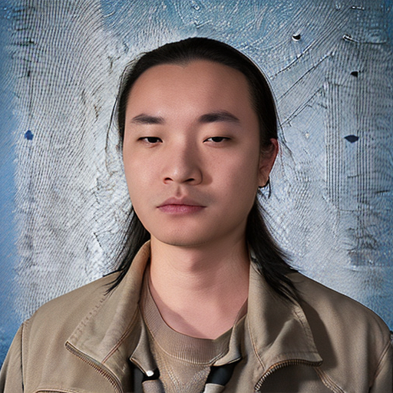
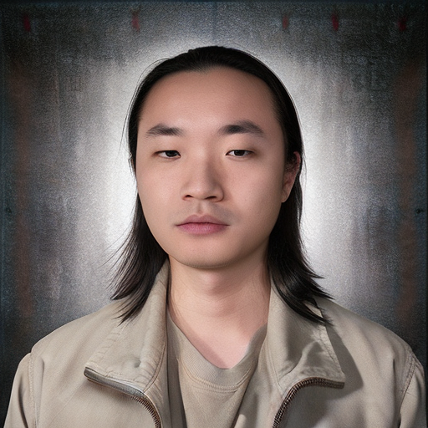
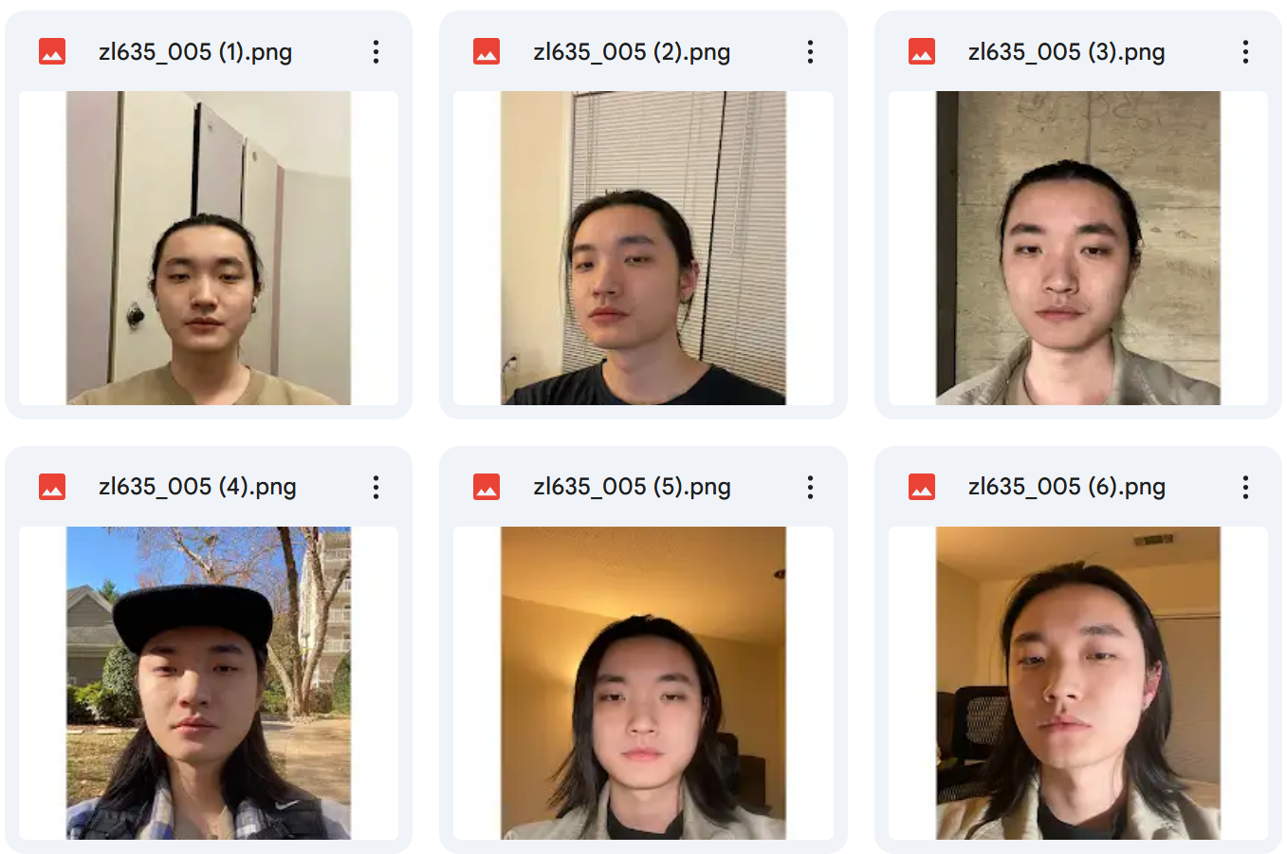
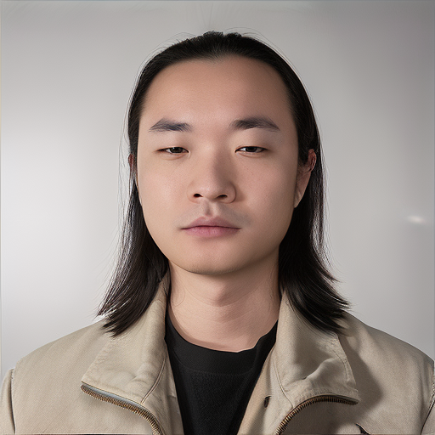
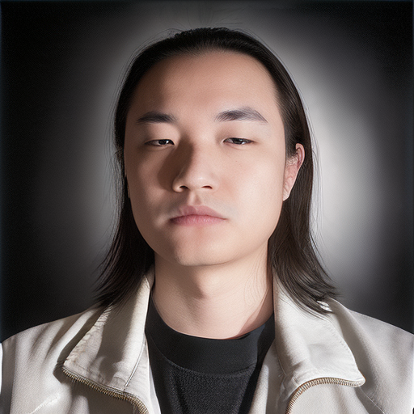
Experiments
zl635_005
Replaced some images to increase variance.
1000 steps per instance.
Overfit?

Slide 26
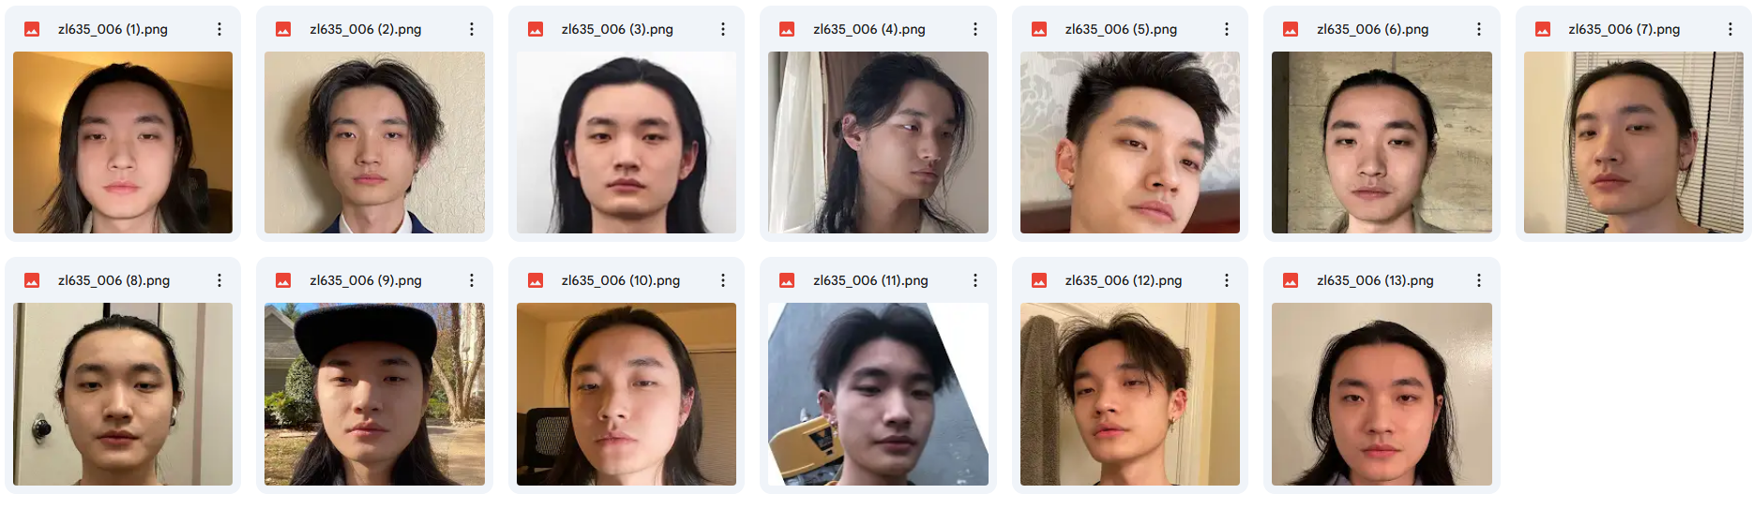
Experiments
zl635_006
13 instances. More variance.
Cropped to only head and neck.
300 steps per instance.

Slide 27
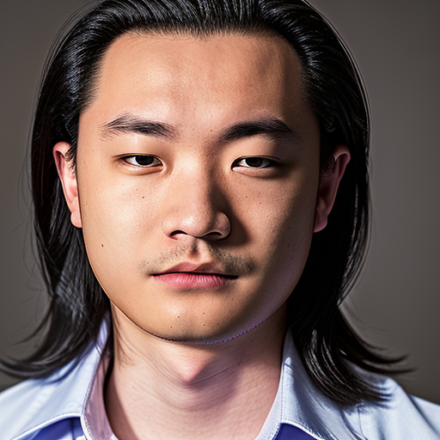
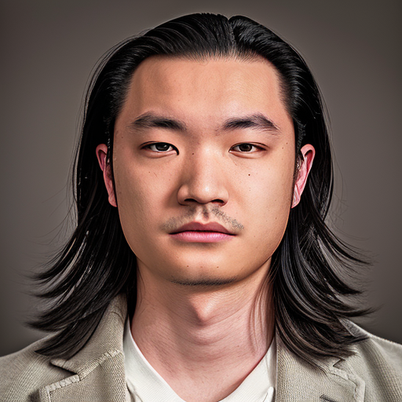
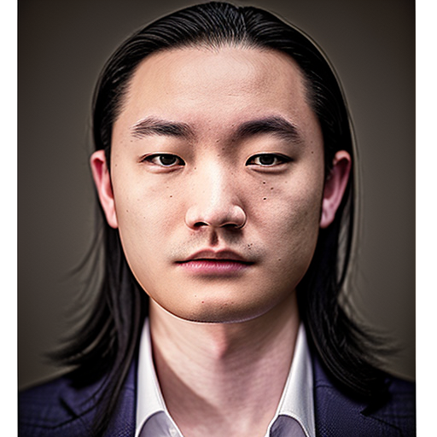
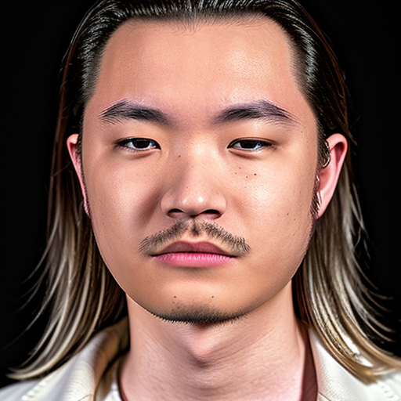
Experiments
Starting to generate some better results.

Slide 28
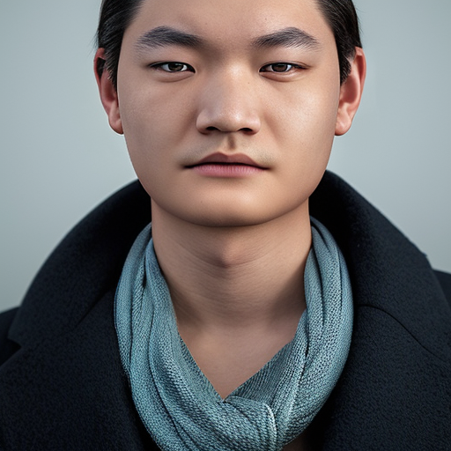
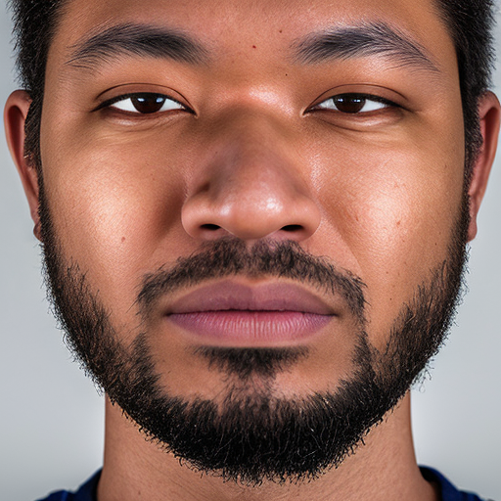
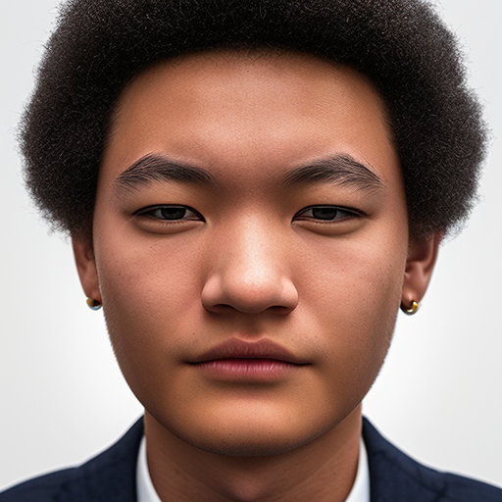
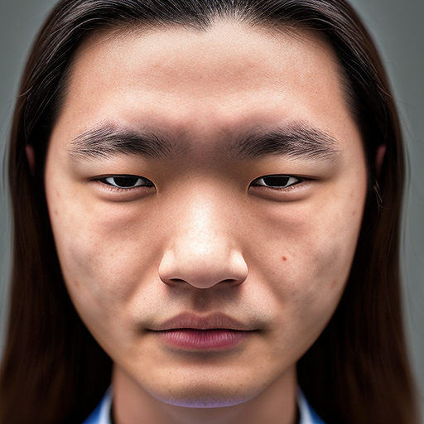
Experiments
zl635_007
Changed LR from 2e-6 to 2e-7. 900 steps per instance.
Results were not desirable.

Slide 29




Experiments
zl635_008
LR changed back to 2e-6.
500 steps per instance.

Slide 30




Experiments
zl635_009
700 steps per instance.
Not as good as zl635_008, maybe overfitting?

Slide 31
Experiments
Best model: zl635_008
13 instances with some variance.
LR = 2e-6 and 500 steps per instance.
More training data (13) than original work (4-6) and the right LR and steps.

Slide 32
Experiments
With the success of the 1st subject, we moved on to fine-tune a 2nd model to see if we can replicate the success, and to evaluate the effects of training data and hyperparameters.

Slide 33
Evaluation

Slide 34
Evaluation
Perceptual Similarity (LPIPS): measure the perceptual similarity between two images. (the smaller, the better)
FID (Frechet Inception Distance): evaluate the quality of generated images by comparing their feature distributions with those of real images. (the smaller, the better)
use 18 original images and 20 generated images each model for evaluation.

Slide 35
Evaluation
 | CYR_001 | CYR_002 | CYR_003 | CYR_004 | CYR_005 | CYR_006 | CYR_007 | CYR_mix
LR | 2e-6 | 2e-6 | 2e-5 | 5e-6 | 2e-6 | 2e-6 | 2e-6 | 2e-6
Steps | 100 | 150 | 100 | 100 | 75 | 250 | 500 | 100
LPIPS | 0.6780 | 0.6830 | 0.6044 | 0.6526 | 0.6891 | 0.6662 | 0.6590 | 0.6601
FID | 181.207 | 183.073 | 152.9508 | 180.524 | 184.895 | 185.094 | 204.161 | 189.179
Red: Best Result
Orange: Second Best Result
Yellow: Thirst Best Result

Slide 36



Evaluation
CYR_001
Learning Rate: 2e-6 100 steps per instance
LPIPS: 0.6780
FID: 181.2075

Slide 37


Evaluation
CYR_002
Learning Rate: 2e-6 150 steps per instance
LPIPS: 0.6830
FID: 183.0726

Slide 38


Evaluation
CYR_003
Learning Rate: 2e-5 100 steps per instance
LPIPS: 0.6044
FID: 152.9508

Slide 39


Evaluation
CYR_004
Learning Rate: 5e-6 100 steps per instance
LPIPS: 0.6526
FID: 180.5239

Slide 40


Evaluation
CYR_005
Learning Rate: 2e-6 75 steps per instance
LPIPS: 0.6891
FID: 184.8948

Slide 41


Evaluation
CYR_006
Learning Rate: 2e-6 250 steps per instance 9 instance
LPIPS: 0.6662
FID: 185.0944

Slide 42


Evaluation
CYR_007
Learning Rate: 2e-6 500 steps per instance
LPIPS: 0.6590
FID: 204.1613

Slide 43



Evaluation
CYR_mix
Learning Rate: 2e-6 100 steps per instance 10 instance each face
LPIPS: 0.6601
FID: 189.1789
Trained with two different face datasets

Slide 44
Evaluation
 | CYR_001 | CYR_002 | CYR_003 | CYR_004 | CYR_005 | CYR_006 | CYR_007 | CYR_mix
LR | 2e-6 | 2e-6 | 2e-5 | 5e-6 | 2e-6 | 2e-6 | 2e-6 | 2e-6
Steps | 100 | 150 | 100 | 100 | 75 | 250 | 500 | 100
LPIPS | 0.6780 | 0.6830 | 0.6044 | 0.6526 | 0.6891 | 0.6662 | 0.6590 | 0.6601
FID | 181.207 | 183.073 | 152.9508 | 180.524 | 184.895 | 185.094 | 204.161 | 189.179
Red: Best Result
Orange: Second Best Result
Yellow: Thirst Best Result

Slide 45





Evaluation
CYR_003
LPIPS: 0.6044
FID: 152.9508
CYR_004
LPIPS: 0.6526
FID: 180.5239
CYR_001
LPIPS: 0.6780
FID: 181.2075
CYR_007
LPIPS: 0.6590
FID: 204.1613

Slide 46
References
[1]. T. Karras, S. Laine, and T. Aila, "A Style-Based Generator Architecture for Generative Adversarial Networks," arXiv preprint arXiv:1812.04948, Dec. 2018. [Online]. Available: https://doi.org/10.48550/arXiv.1812.04948
[2]. J. Ho, A. Jain, and P. Abbeel, "Denoising Diffusion Probabilistic Models," arXiv preprint arXiv:2006.11239, Jun. 2020. [Online]. Available: https://doi.org/10.48550/arXiv.2006.11239
[3]. R. Rombach, A. Blattmann, D. Lorenz, P. Esser, and B. Ommer, "High-Resolution Image Synthesis with Latent Diffusion Models," arXiv preprint arXiv:2112.10752, Dec. 2021. [Online]. Available: https://doi.org/10.48550/arXiv.2112.10752
[4]. A. Radford et al., "Learning Transferable Visual Models From Natural Language Supervision," arXiv preprint arXiv:2103.00020, Mar. 2021. [Online]. Available: https://doi.org/10.48550/arXiv.2103.00020
[5]. C. Saharia et al., "Photorealistic Text-to-Image Diffusion Models with Deep Language Understanding," arXiv preprint arXiv:2205.11487, May 2022. [Online]. Available: https://doi.org/10.48550/arXiv.2205.11487
[6]. R. Gal, A. Alaluf, Y. Atzmon, O. Patashnik, A. Bermano, G. Chechik, and D. Cohen-Or, "An Image is Worth One Word: Personalizing Text-to-Image Generation using Textual Inversion," arXiv preprint arXiv:2208.01618, Aug. 2022. [Online]. Available: https://doi.org/10.48550/arXiv.2208.01618
[7]. R. Roich, A. Mokady, A. Bermano, D. Cohen-Or, and D. Lischinski, "Pivotal Tuning for Latent-based Editing of Real Images," arXiv preprint arXiv:2106.05744, Jun. 2021. [Online]. Available: https://doi.org/10.48550/arXiv.2106.05744
[8]. N. Ruiz, Y. Li, V. Jampani, D. P. W. Ellis, and A. Veit, "DreamBooth: Fine Tuning Text-to-Image Diffusion Models for Subject-Driven Generation," arXiv preprint arXiv:2208.12242, Aug. 2022. [Online]. Available: https://doi.org/10.48550/arXiv.2208.12242

Slide 47

Thank You!

